Slide 1
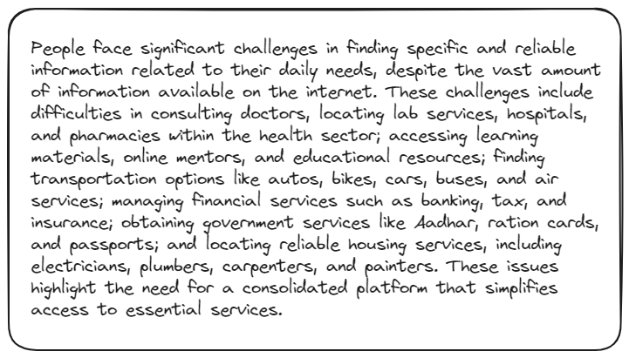
Problem Statement

Slide 2
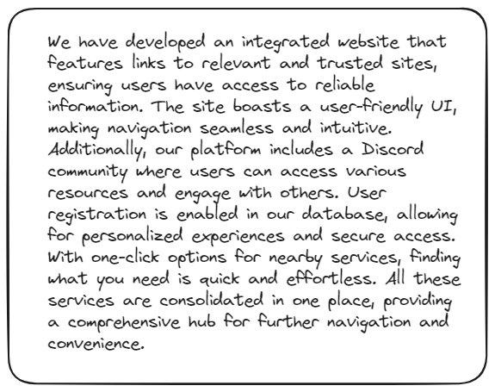
Unique Idea Brief (Solution)

Slide 3
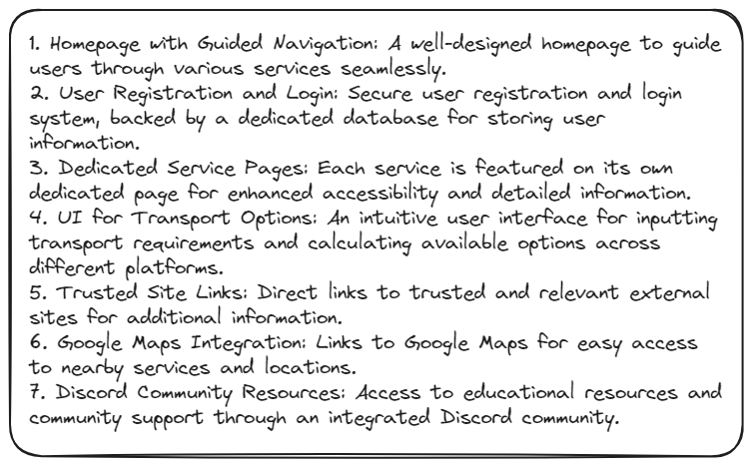
Features Offered

Slide 4
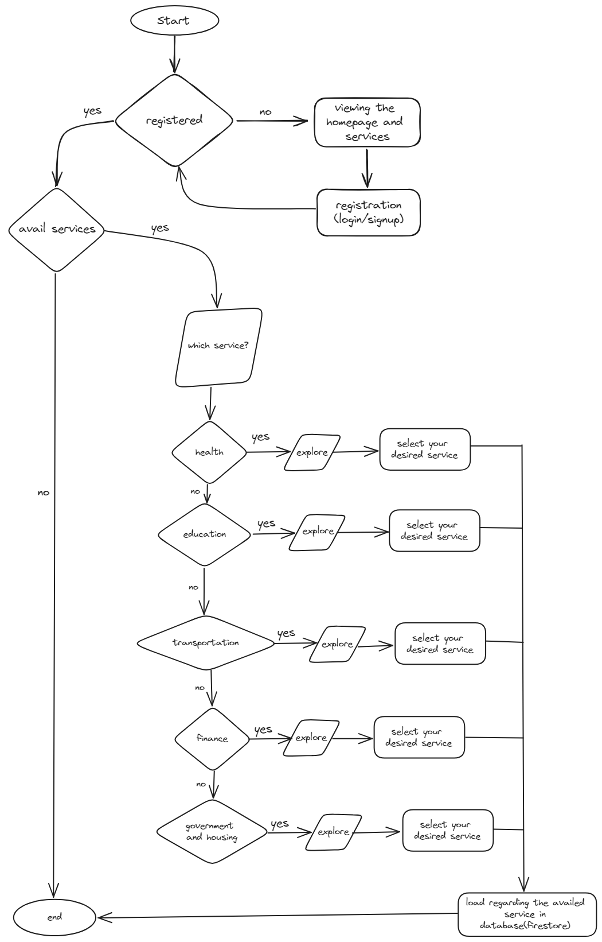

Process flow

Slide 5
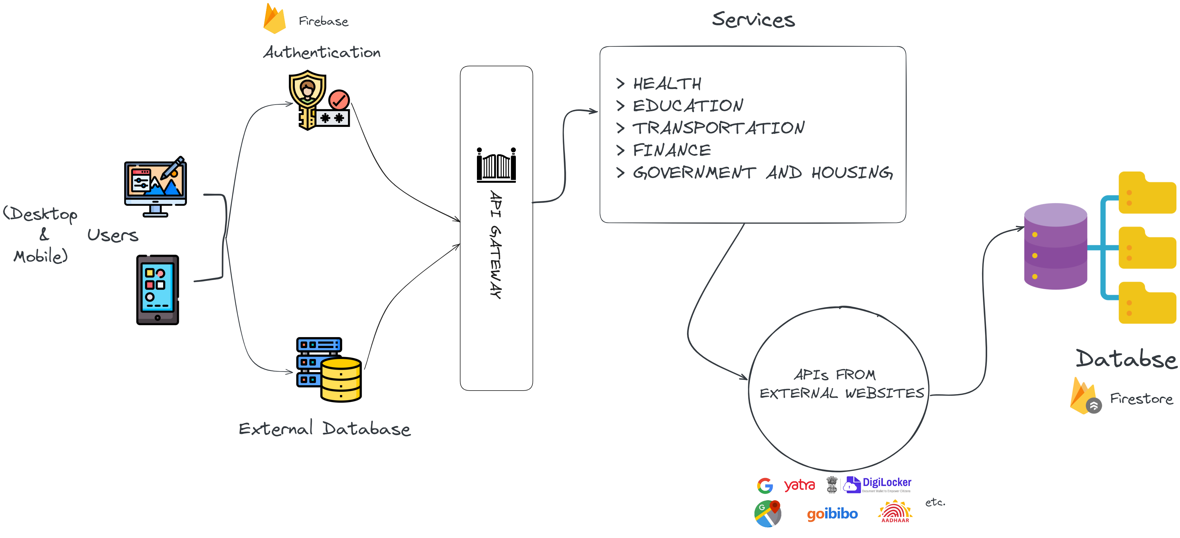
Architectural Diagram

Slide 6

Technologies used

Slide 7
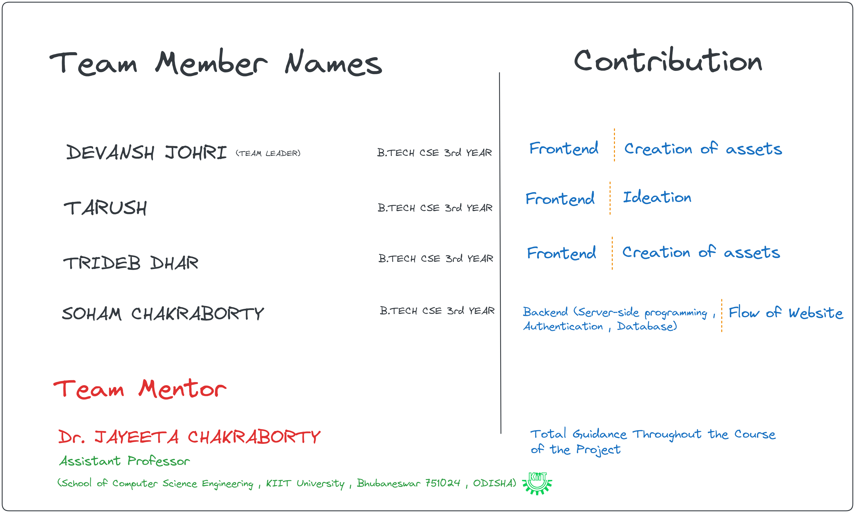
Team members and contribution:

Slide 8

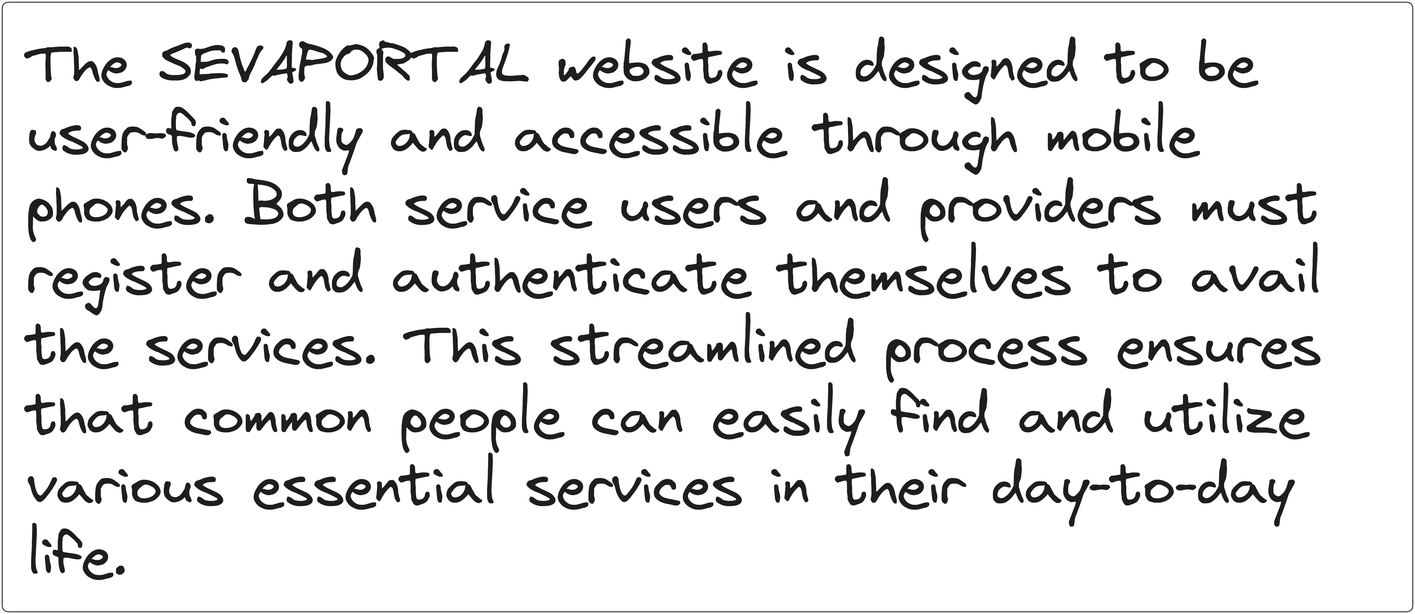


Conclusion

